Slide 1
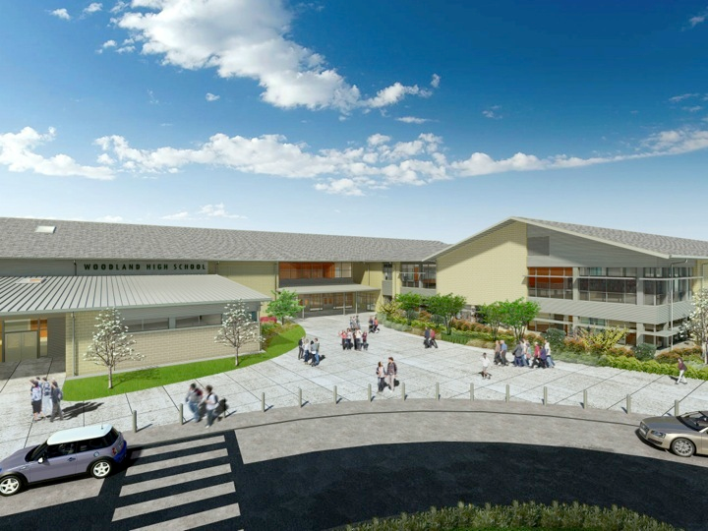
Woodland Public Schools
Facilities and Safety Report
May 2018

Slide 2
FACILITIES REPORT
A splash of color - A survey conducted by WMS Admin revealed that the Yellow and Green halls at WMS were too “institutional“. To correct this observation, our master painter, Odie has been adding accent paint in both hallways for the past few weeks. The new colors (yellow and green) have been laid in alcoves and walls throughout the buildings, to give the hallway a new look.
WPS Portable 11/12 -The rehab of portable 11/12 at WPS is rolling along at a good pace. Both restrooms have been framed in and sheet rocked. The plumber will be in Monday to complete the rough-in for the water and drains. Both rooms have been stripped of carpeting, and a new floor was installed last week in P11. Flooring goes into P12 in the next few days. Walls are getting restored and will be painted shortly. Brad has been fixing areas of dry rot in order to get the building ready for the new siding.
WIS Portable 5/6 – PO’s and permits have been issued for carpet, data, simplex announcing, fire, plumbing and main electrical. The utility trench concrete and blacktop has been cut and rough-in’s will be completed by the end of next week. Shipment of the building is expected on the 19th of July. We will swarm the building with contractors the following two weeks, to complete all of the internal work, in order to get the portable delivered on time to the WIS staff.

Slide 3
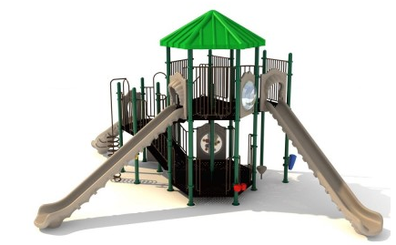
Facilities Report Continued
Exterior masonry work, WMS - The first quote for the repair and cleaning of the masonry work at WMS came in at a whopping $250k. I have decided to move this work to inside maintenance. The work will be completed in smaller sections over a multiple-year schedule (eat an elephant one bite at a time). It will focus on cleaning and repair of mortar joints that have failed. This summer we will focus on the south-facing walls that appear to be in the worst condition.
Yale play system - After a long run, the Yale play
system will be replaced this summer with a new
structure. The new structure will arrive in early
August, which will not give us much time to get it in
the ground and set up. The old system will be
removed, and the ground will be prepped prior to
the system arriving, which should allow for a
quick installation

Slide 4
Facilities Report Continued
Pushing forward on other summer work including:
1. PO’s issued for new roof on Green Gym, this work is expected to be completed by August.
2. Exterior cameras- WPS.
3. Drinking water lines-WPS/WIS.
4. Carpeting and flooring- multiple schools.
5. Roof coating-WPS gym, cafeteria, art and music rooms.
6. Interior and exterior painting-select areas at WMS and WIS.
7. Installing 120 linear feet of sidewalk from Green Gym to Green Hall- WMS.
8. Solar pods 1&2- WHS.
Along with the above major work scheduled, there are numerous other smaller jobs that are included in our summer portfolio. This includes lighting upgrades, painting projects, room re-layouts, and our routine cleaning of rooms and hallways.

Slide 5
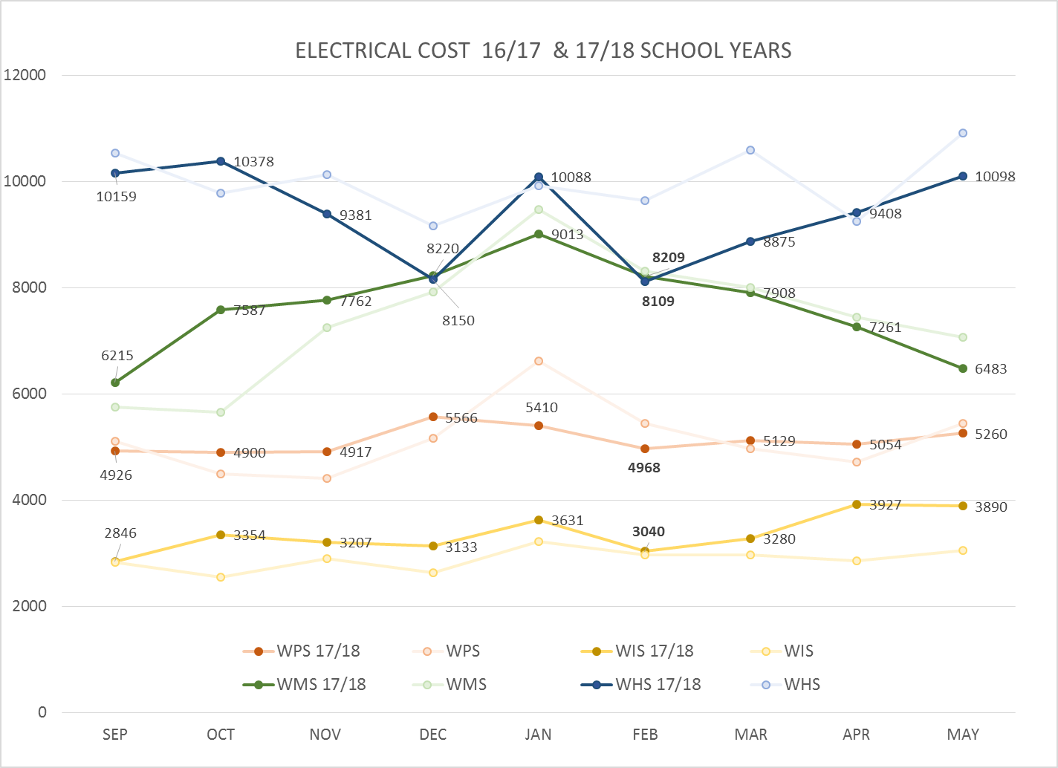
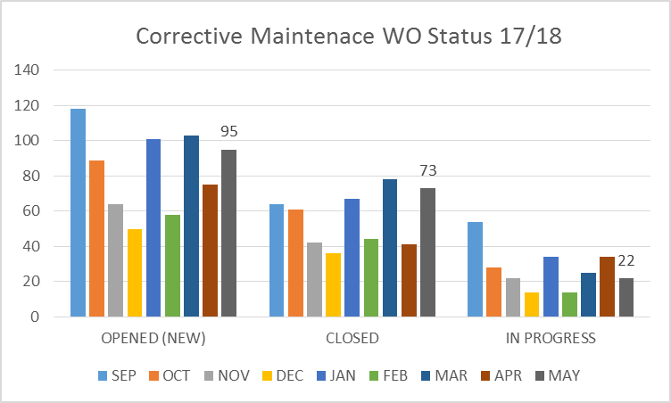
FACILITY CHARTS – POWER COST AND WORK ORDER STATUS
Excessive power consumption at WIS due to HVAC processor failure; part will be received end of June.

Slide 6
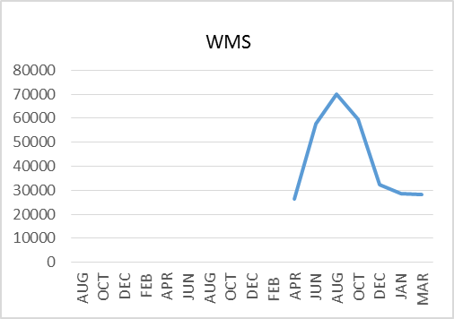
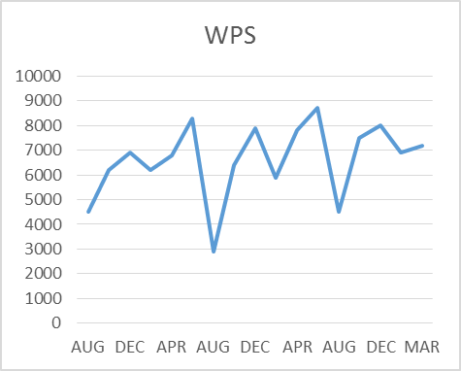
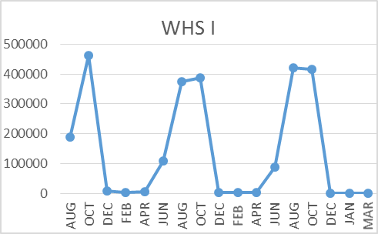
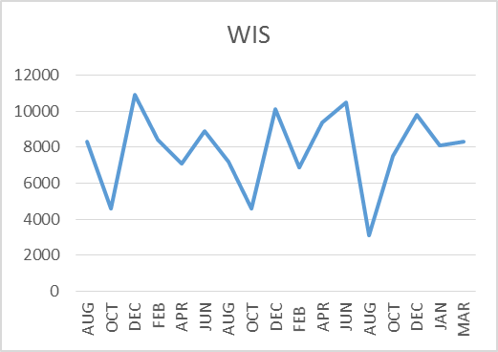
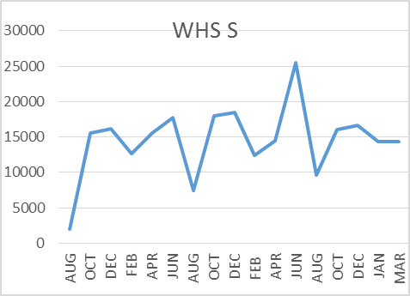
FACILITY CHARTS –
WATER USAGE
WHS, WIS, WMS, WPS
Water charts are updated every two
months. The next update to these charts
is in July 2018.
The WMS chart includes 755 Park St. high and low flow, BO and TEAM High, PIT House, bus barn, athletic field and DO. All of these meters are totaled on the WMS graph; but, each data point is recorded separately, to aid in identifying leaks.

Slide 7
SAFETY REPORT
Accidents/Incidents
There were 6 student and 5 staff accidents/incidents for the month.
WPS
Staff Accidents/Incidents (5)
WMS - Staff injured breaking up fight- bruise.
WIS - Maintenance worker fell from ladder- minor bruise.
WPS - Staff member injured back while positioning student- strain.
WPS - Staff members bit by students on forearm (2).
Student Accidents/Injuries (6)
WHS - Student was hit in head with golf ball - Laceration w/stiches (EMS dispatched).
WMS - Student misjudged curb , flipped wheelchair – no injury received.
WIS - Student fell off monkey bar - hurt neck and back (EMS dispatched).
WPS - Student had chair thrown by other student - minor injury to foot.
WPS - Student fell from play structure – received splinter in hand.
WPS - Student fell on play structure - bruised knees.

Slide 8
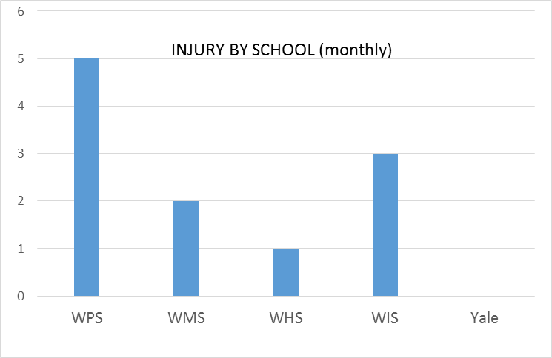
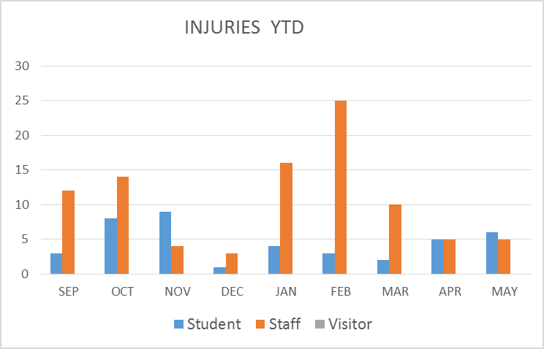
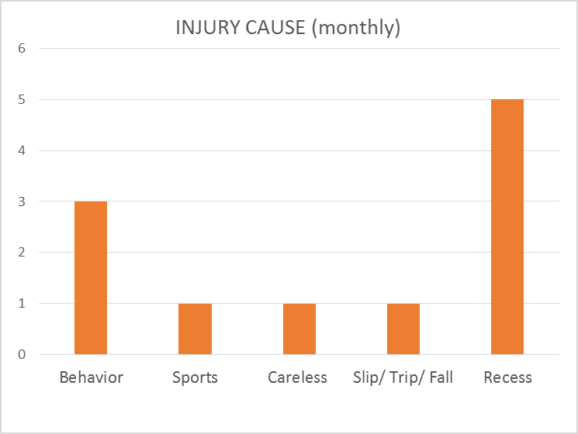
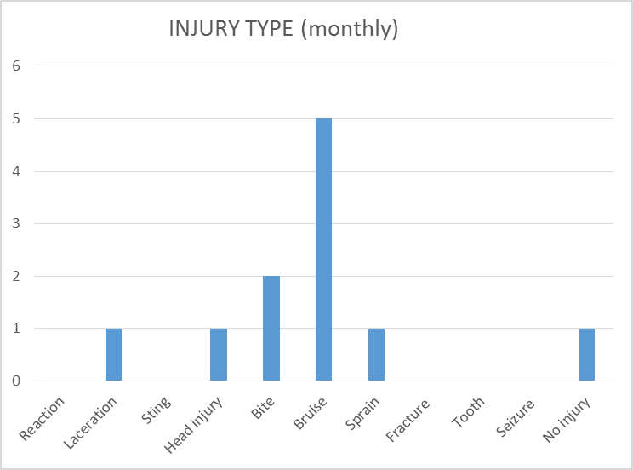
SAFETY CHARTS

